Slide 1
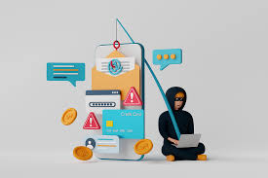
Phishing awareness training
name : saloni r chaurasiya

Slide 2
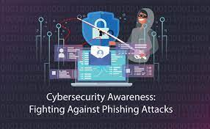
* Contents
Introduction
Phishing attacks and Its awareness
Typical scenario of phishing
Type of phishing attacks
Phishing statistics in India
Preventing, recognizing, avoiding
Conclusion

Slide 3
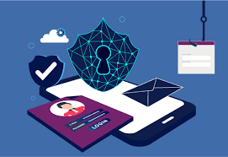
* Introduction
Phishing is a type of social engineering attack
often used steal user data, including login credentials
and credit card numbers.

Slide 4
* Phishing attacks and Its awareness
The term Phishing can be defined as an act of attempting to acquire sensitive information by pretending to be a trustworthy entity.
Its importance to be aware about phishing , how dose it work ? , how it attack ? , how it gather information ? So lets see …

Slide 5
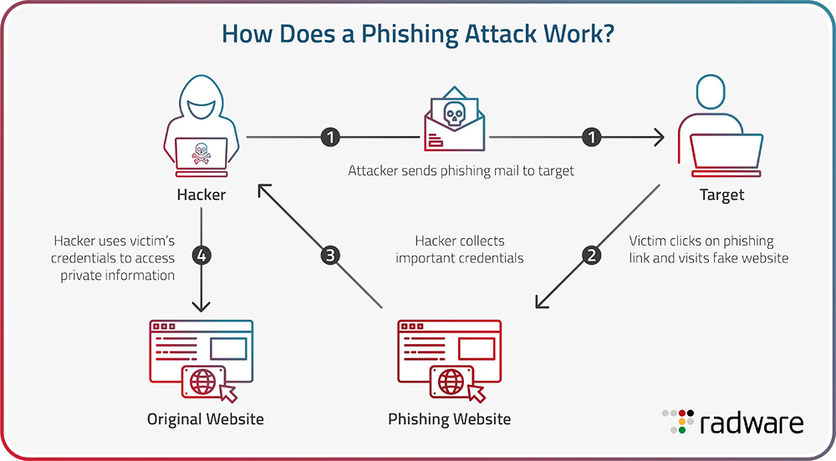
* Typical scenario of phishing
add image

Slide 6
* Type of phishing attacks
Email Phishing : its most widely known from of phishing, this attack is an attempt to steal sensitive information via an email that appears to be from a legitimate organization.
Spear phishing : These email message are sent to specific people within an organization, usually high-privilege.
Voice phishing : Vishing-or voice phishing-is the use of fraudulent phone calls to trick people into giving money or revealing personal information.

Slide 7
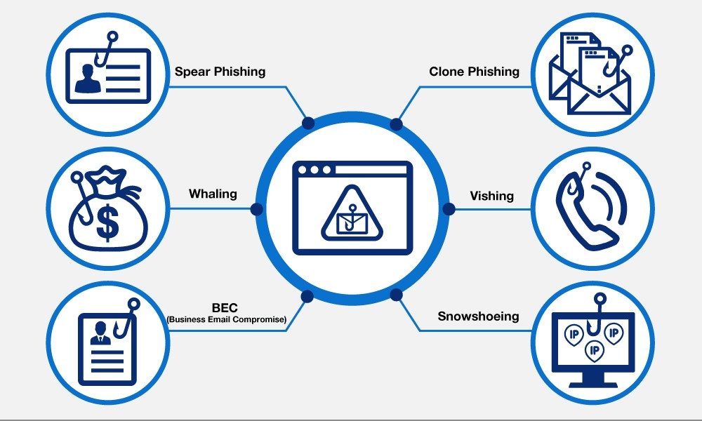

Slide 8
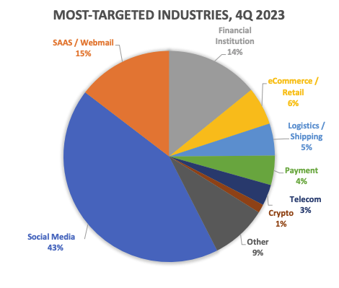
* Phishing statistics in India
According to a Proofpoint study, 71% of all companies experienced a successful phishing attack in 2023.
The most targeted industry sector in 2023 was social media , comprising 42.8% of phishing attacks.

Slide 9
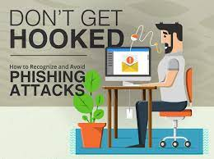
* Preventing, recognizing, avoiding
Know what a phishing scam looks like.
Use Security Software and Tools.
Verify Unusual Account Activity.
Verify sender Addresses.
Check for Suspicious Links.
Be wary of Email Attachments.
Avoid sharing personal or financial Information through Emails.
Report Suspicious Emails.

Slide 10
* Conclusion
No single technology will completely stop Phishing Attacks.
However a combination of good organization and practice. Proper application of current technologies and improvement in security technology has the potential to drastically reduce the prevalence of phishing and the losses suffered from it.

Slide 11
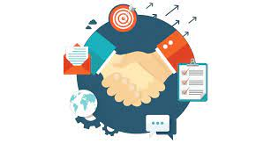
Thank you

